Slide 1






MUSIC PERFORMANCE &
STREAMING ANALYTICS
DATA CLEANING, ANALYSIS &
BUSINESS INSIGHTS
Presented by
Team ANB 19
Team 2

Slide 2



PROJECT OVERVIEW
Our objective was to analyse music streaming data from multiple platforms to uncover trends, measure performance, and provide actionable business insights.
Identify top performing tracks and artists.
Understand audience engagement.
Compare performance across platforms.
Discover trends over time.
Generate insights for business decision
Presented by
Team ANB 19
Team 2

Slide 3


DATASET OVERVIEW
Total Records : | 4,600
Total Columns : | 27
Platforms Streams : | Spotify, YouTube, TikTok, Apple Music, Deezer, Amazon, Airplay Spin, SiriusXM Spin, Pandora, Soundcloud and Shazam
Data Type : | Categorical + Numerical
Time Span : | Multiple Release Years
Presented by
Team ANB 19
Team 2

Slide 4






DATASET CHALLENGES
Missing Values
Duplicate Entries
Inconsistent Formats
18,194
2 Records
Casing issues and mixed
numeric syntax styles
Mixed Date Formats
Mixed Languages in Text
Null Values & Outliers
Varying date strings
(YYYY-MM-DD vs DD/MM/YYYY)
Categorical columns featuring untranslated multilingual data
Incomplete records skewing
general statistical metrics
Presented by
Team ANB 19
Team 2

Slide 5






DATA CLEANING PROCESS
1.Raw Data Collection
2.Handling Missing Values
Gathered unprocessed information
Identified and treated missing data
3.Formatting & Standardization
4.Date Format Standardization
Converted all dates to a consistent
format
Standardized text, numbers & categories
5.Language & Text Cleaning
6.Consistency Check
Translated & entered 120 datas manually
in mixed language text
Validated data for consistency & accuracy
7.Clean Dataset
High quality data ready for analysis
Presented by
Team ANB 19
Team 2

Slide 6


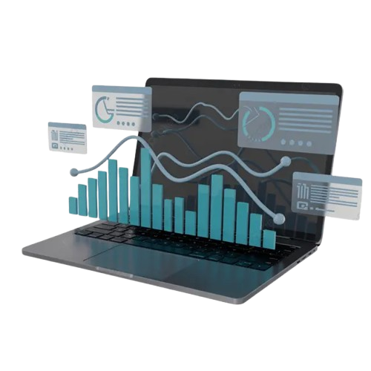


TOOLS & METHODOLOGY
EXCEL
Data Cleaning
Formatting
Validation
POWER QUERY
Data Transformation
Merging Queries
Data Shaping
POWER BI
DAX
Dashboard Creation
Insights & Visualization
Presented by
Team ANB 19
Team 2

Slide 7

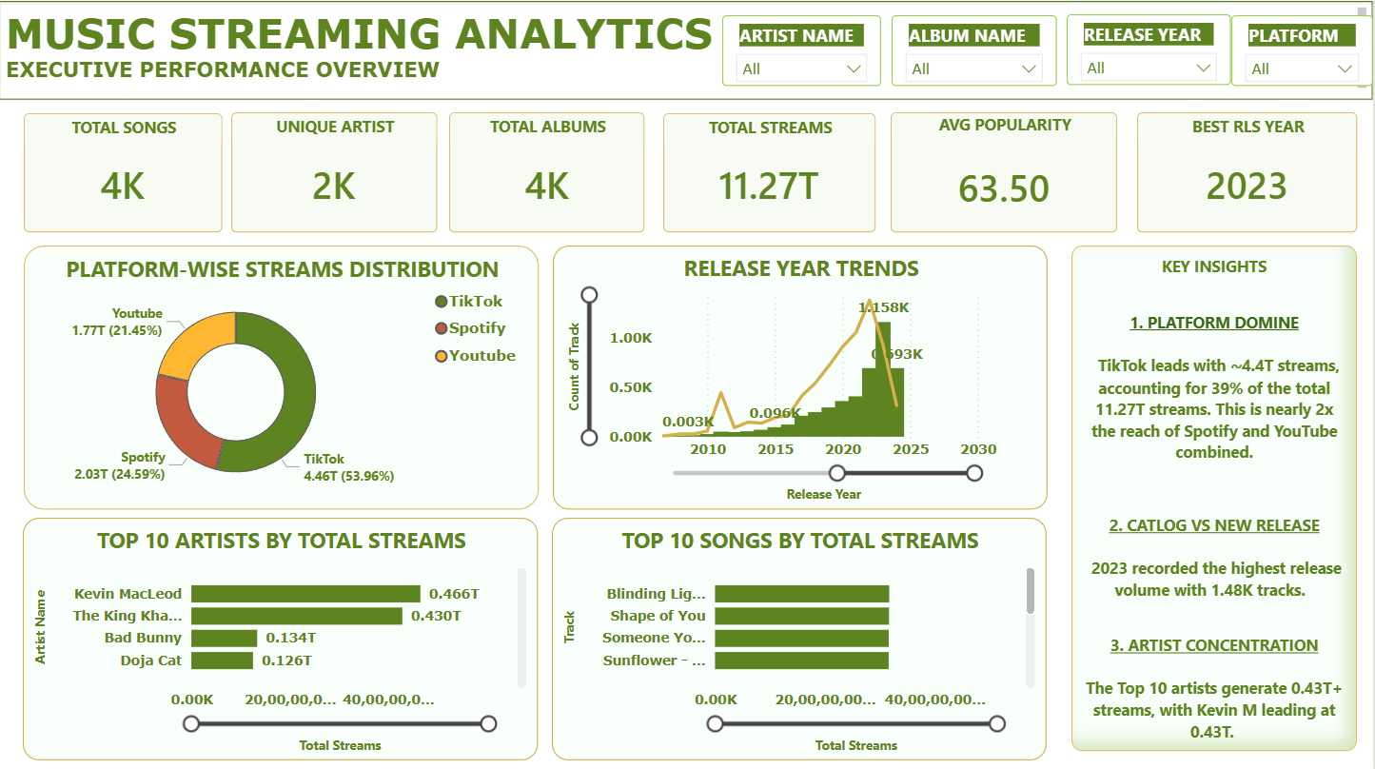
DASHBOARD OVERVIEW
Presented by
Team ANB 19
Team 2

Slide 8
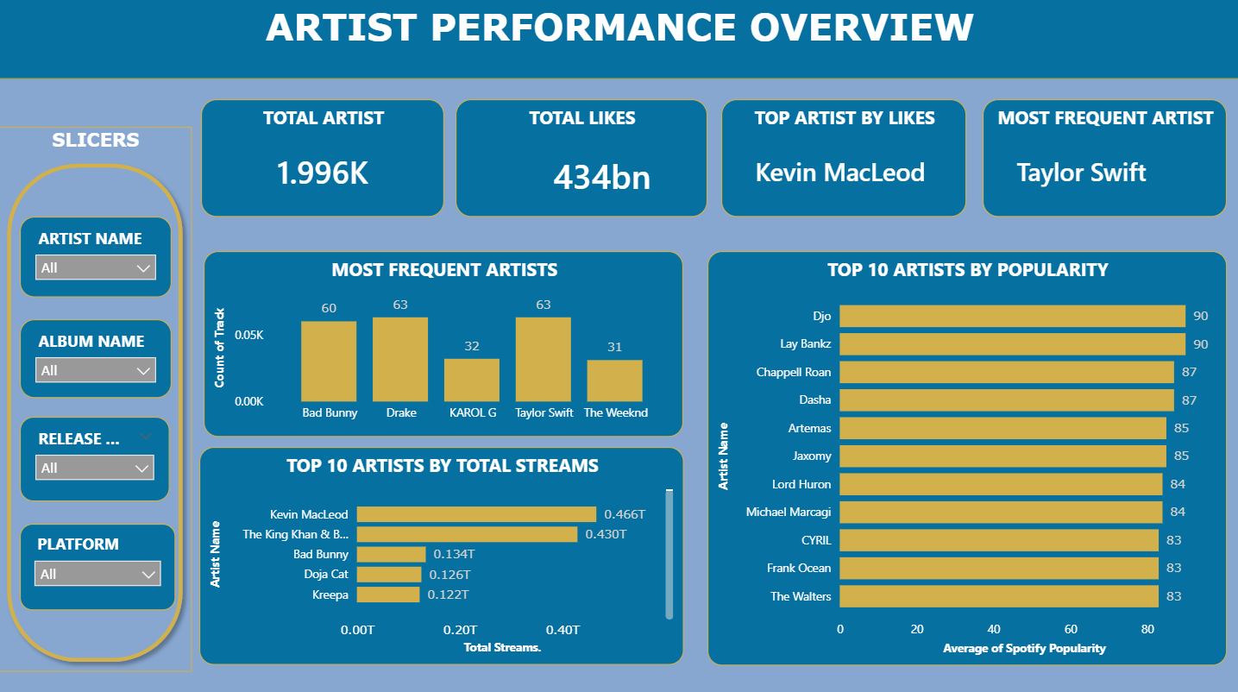
COMPARISON WITH ARTIST
Presented by
Team ANB 19
Team 2

Slide 9
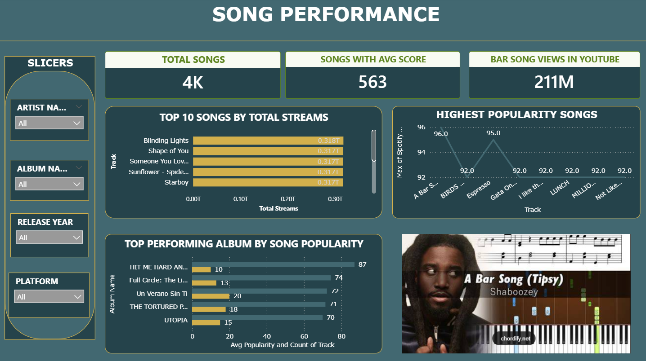
COMPARISON WITH SONGS
Presented by
Team ANB 19
Team 2

Slide 10
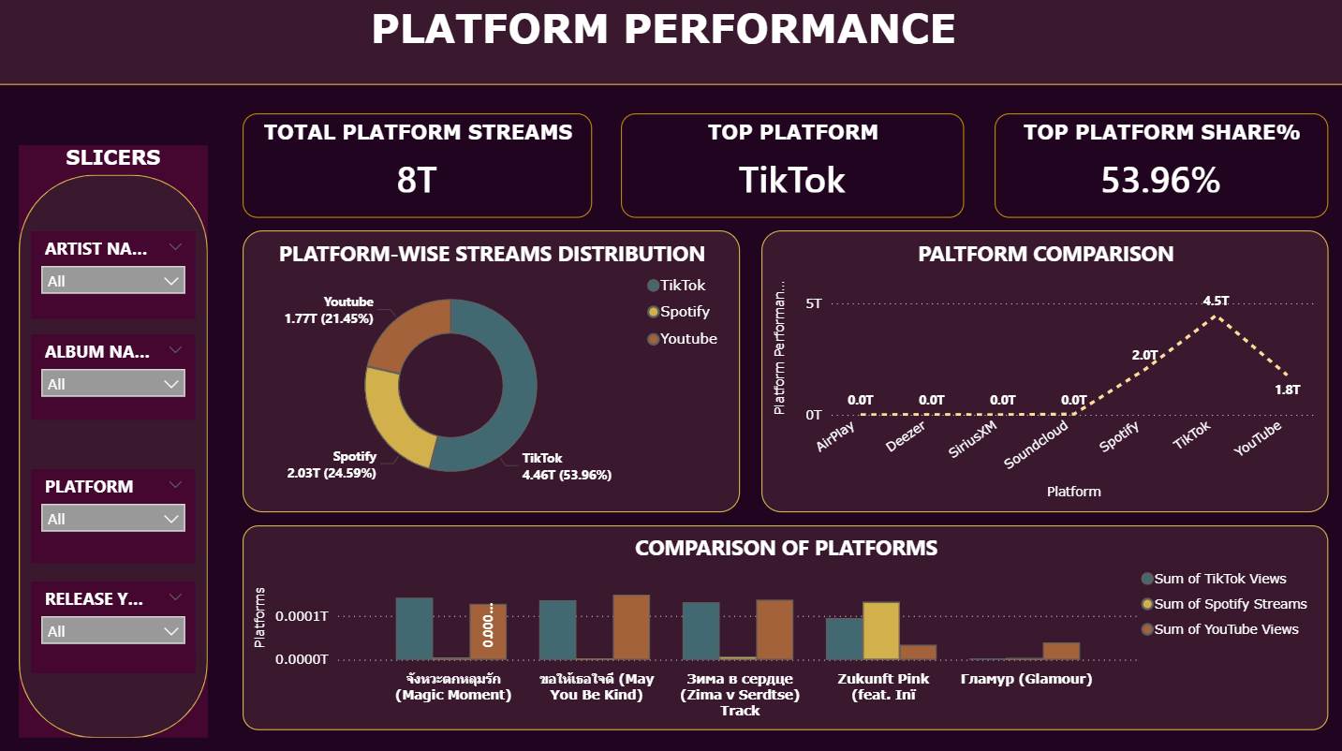
COMPARISON WITH PLATFORM
Presented by
Team ANB 19
Team 2

Slide 11
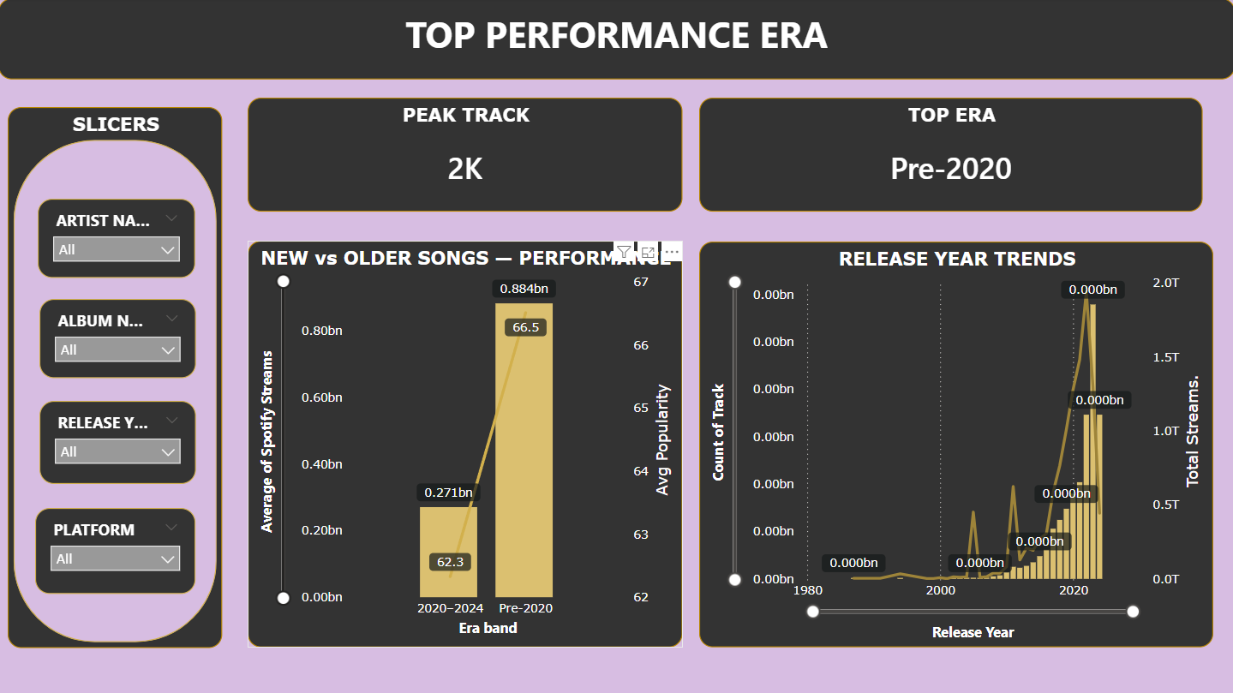
COMPARISON WITH TRENDS
Presented by
Team ANB 19
Team 2

Slide 12
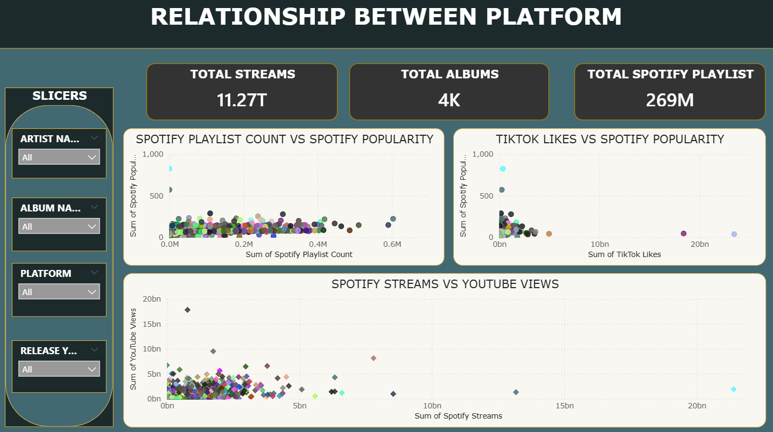
RELATIONSHIP WITH PLATFORMS
Presented by
Team ANB 19
Team 2

Slide 13
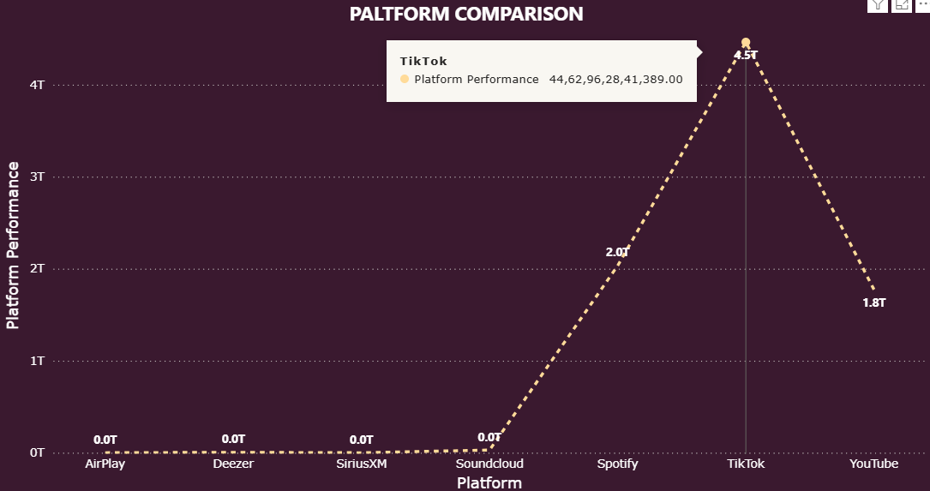
CROSS-PLATFORM COMPARISON
(TOTAL STREAMS / VIEW)
Presented by
Team ANB 19
Team 2

Slide 14
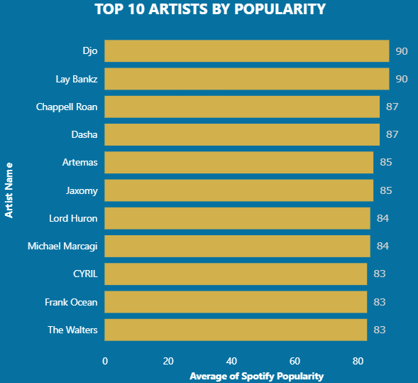
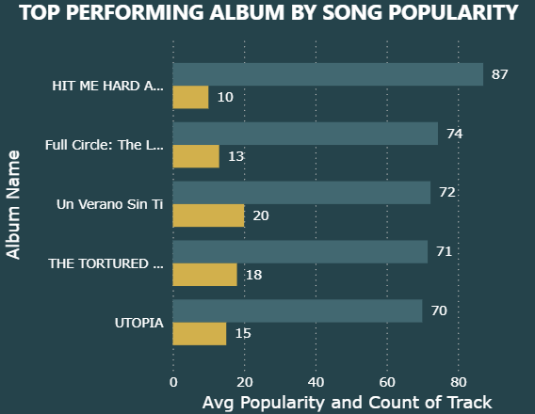
ARTIST & TRACK PERFORMANCE
Presented by
Team ANB 19
Team 2

Slide 15
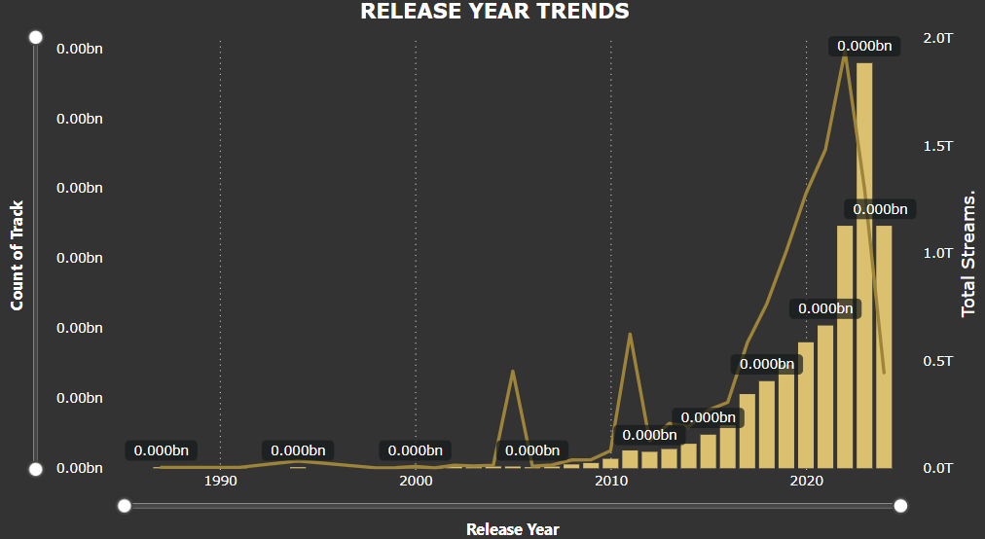
TRENDING ANALYSIS(BY RELEASE YEAR)
Presented by
Team ANB 19
Team 2

Slide 16


BUSINESS INSIGHTS
1.Popular Artist
Joe Keery - “Djo”
Layia Watkins -“Lay Bankz”
Presented by
Team ANB 19
Team 2

Slide 17

BUSINESS INSIGHTS
2.Top Track
1.Popular Artist
Presented by
Team ANB 19
Team 2

Slide 18

BUSINESS INSIGHTS
3.Album Song
Presented by
Team ANB 19
Team 2

Slide 19

BUSINESS INSIGHTS
4. TIK TOK -Strongest Impact
Presented by
Team ANB 19
Team 2

Slide 20

BUSINESS INSIGHTS
5. SPOTIFY – Maximum streaming
Presented by
Team ANB 19
Team 2

Slide 21

BUSINESS INSIGHTS
6.You Tube – Highest view
Presented by
Team ANB 19
Team 2

Slide 22
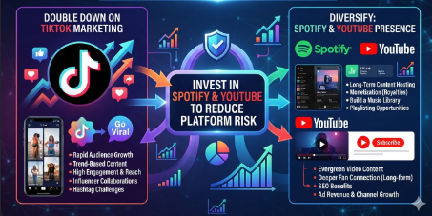
BUSINESS RECOMMENDATIONS
1.Investing in Spotify or YouTube to reduce platform risk
Presented by
Team ANB 19
Team 2

Slide 23
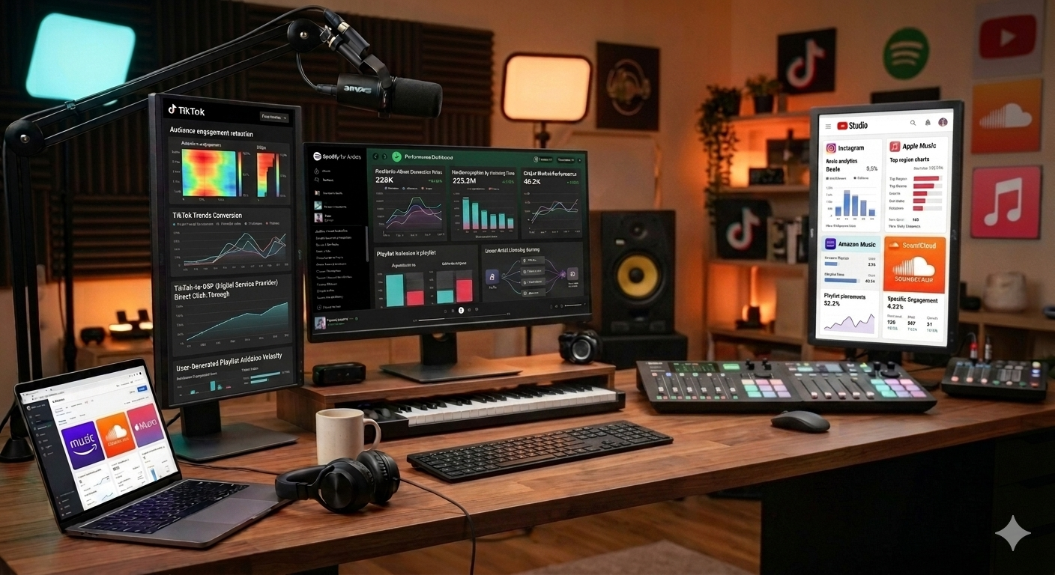
BUSINESS RECOMMENDATIONS
2.Monitor song performance
Presented by
Team ANB 19
Team 2

Slide 24
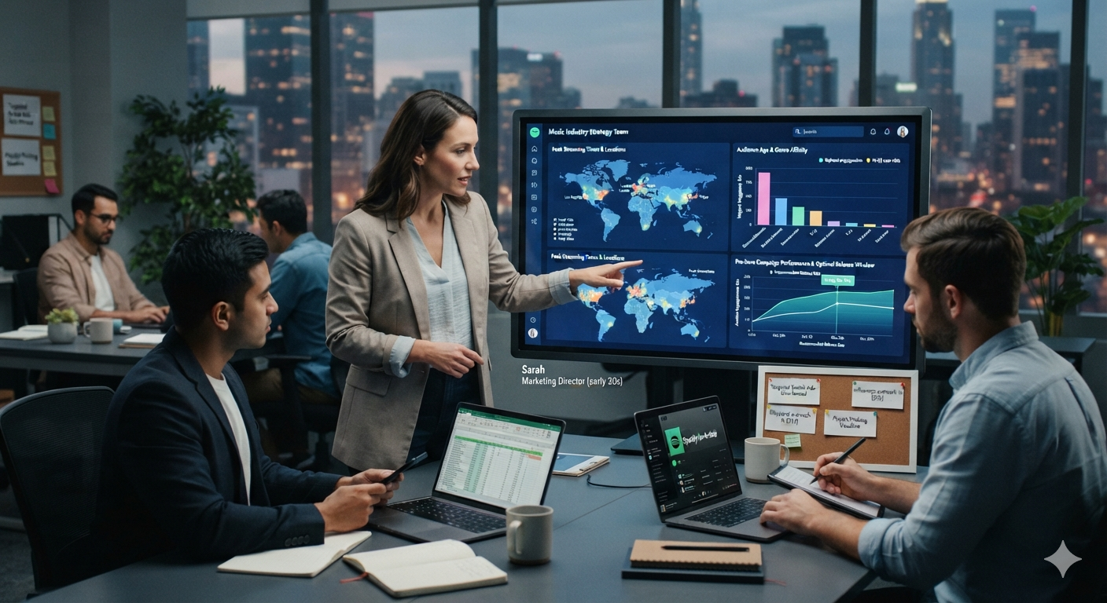
BUSINESS RECOMMENDATIONS
3.Release music strategically based on location
Presented by
Team ANB 19
Team 2

Slide 25

BUSINESS RECOMMENDATIONS
4. Shaboozey’s "A Bar Song“(Tipsy) and collaborate with creators like Kevin MacLeod
Presented by
Team ANB 19
Team 2

Slide 26

BUSINESS RECOMMENDATIONS
5. Blinding Lights by Weeknd
Presented by
Team ANB 19
Team 2

Slide 27
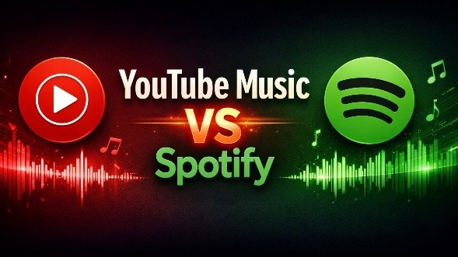
BUSINESS RECOMMENDATIONS
5. Comparison between
Platforms by Artist
Presented by
Team ANB 19
Team 2

Slide 28

THANK YOU
QUESTIONS ? QUERIES ?
Presented by
Team ANB 19
Team 2

